Slide 1


Applied Virtual Networks
COMP 4912
Instructor: Dawood Sajjadi
PhD, SMIEEE, CISSP
ssajjaditorshizi@bcit.ca
Winter-Spring 2025
Week #6

Slide 2
Selected Topics for the Course Projects
Cusson
Kubernetes Multi-Cluster Management: Challenges and Solutions
Investigate the latest tools and strategies for managing multiple Kubernetes clusters, including federation, hybrid cloud setups, and edge computing.
Jenny
Edge Computing with Kubernetes: KubeEdge and MicroK8s
Investigate how Kubernetes is being adapted for edge computing scenarios using projects like KubeEdge and MicroK8s.
Jimmy
Emerging Virtualization Technologies: Firecracker, gVisor, and Kata Containers
Investigate lightweight virtualization technologies like Firecracker (AWS Lambda), gVisor (Google), and Kata Containers for secure and efficient workloads.
Rahat
OpenStack as a Private Cloud Solution: Architecture, Use Cases, and Challenges
Explore the architecture of OpenStack, its components (Nova, Neutron, Cinder, etc.), and its role in building private clouds.

Slide 3
Learning Outcomes of Week #6
Explaining the necessity of using Public Cloud services such as Amazon Web Service (AWS).
Describing the key terminologies to deploy VMs (instances) in AWS.
Understanding security model and measures introduced by the AWS.
Explaining the storage options provided by the AWS to the users
Grasping Virtual Private Cloud (VPC) concept and its applications in public cloud.
Finding out how to define a Security Group to manage access to instances.

Slide 4

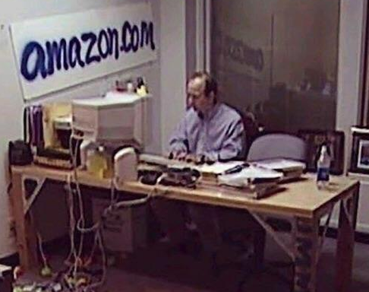

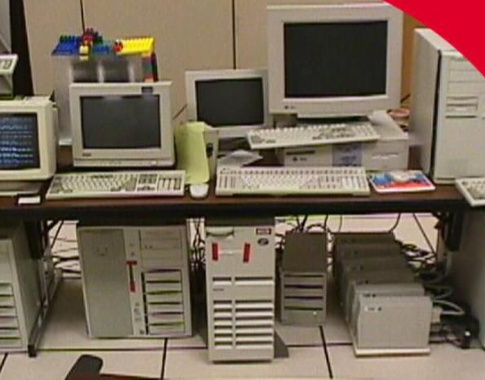

Internet & Servers
Internet

Slide 5
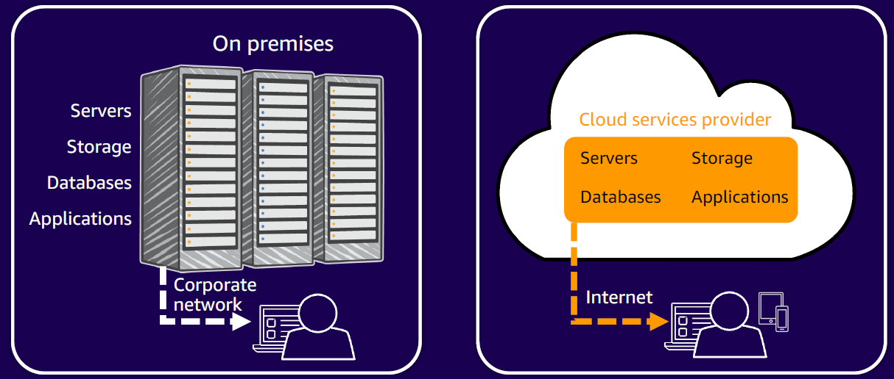
On-Premise vs. Cloud
Reference: AWSome Day, Michalynn J. Koziol (2024)

Slide 6




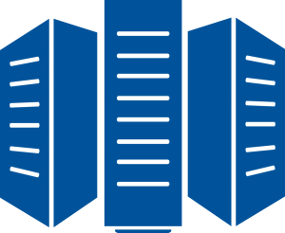
Secure Access to Servers
Brach Offices
Brach Offices
Brach Offices
Employees
Internet
Internet
Customers
VPN/Firewall
Servers
in Data Centers
HQ

Slide 7



Connected to the HQ

Slide 8
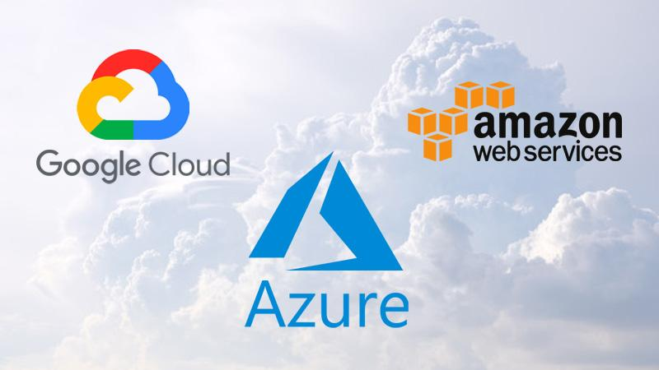
Emergence of Public Clouds
2006
2011
2010
Spacelift report (Mar 2024)
Gartner report (Nov 2023)

Slide 9
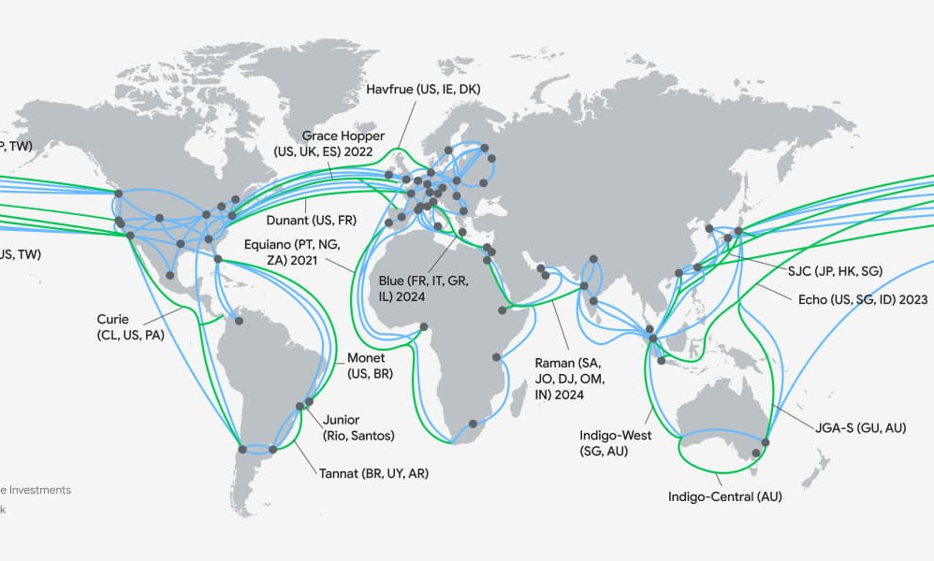
Emergence of Public Clouds
Notes:
AWS over 200 active data center globally + 600 POP sites
Azure has over 200 data center globally.
GCP has around 50 data center globally.

Slide 10
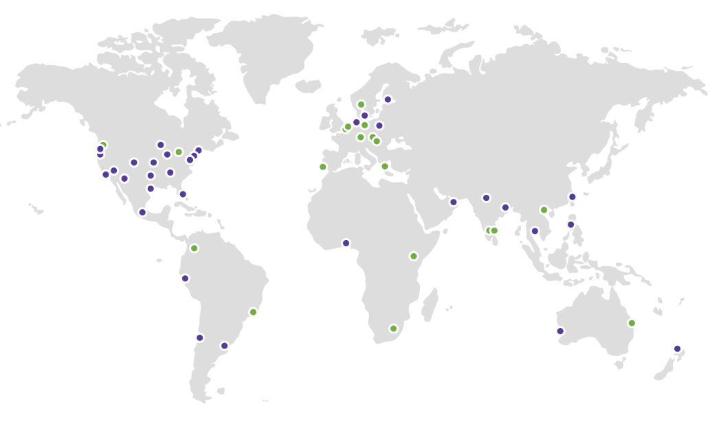
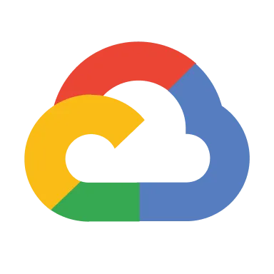



Connecting to the closest site
by: Dawood Sajjadi

Slide 11
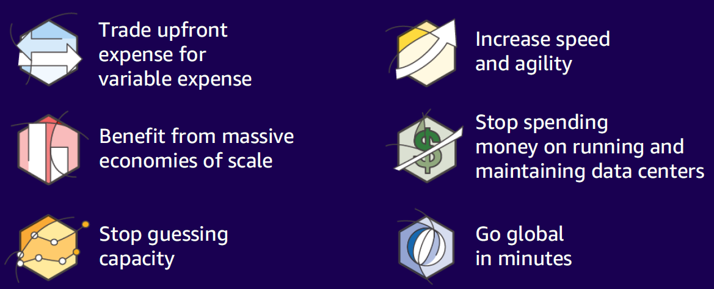
Key advantages of Public Cloud (Cloud Computing)
Reference: AWSome Day, Michalynn J. Koziol (2024)

Slide 12
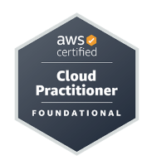
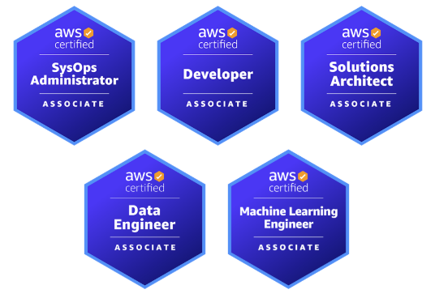
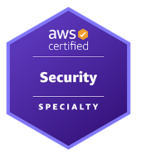
AWS Certifications
https://aws.amazon.com/certification/

Slide 13
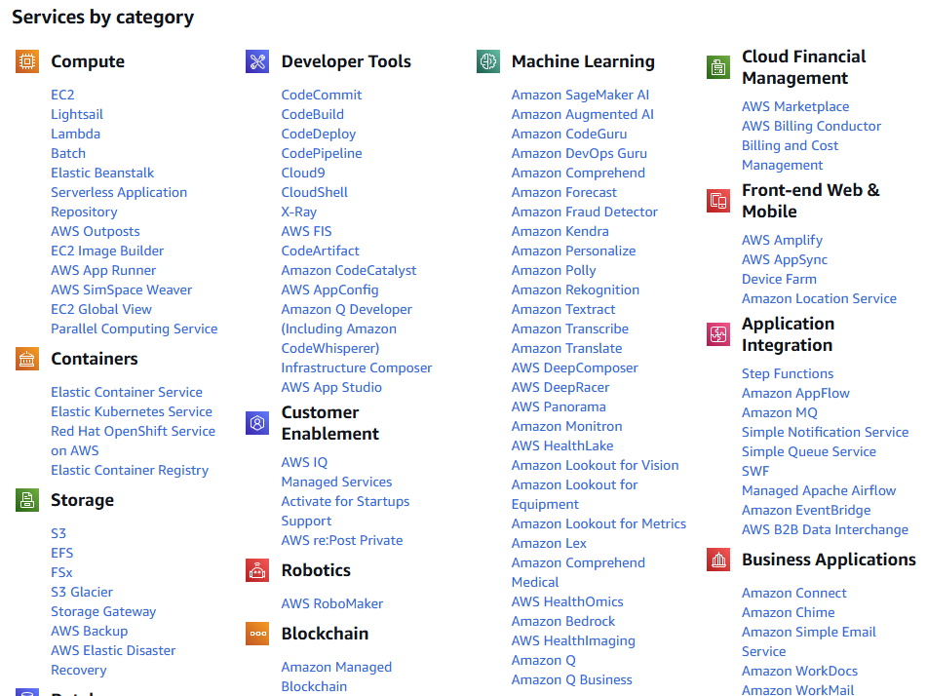
List of All Services

Slide 14
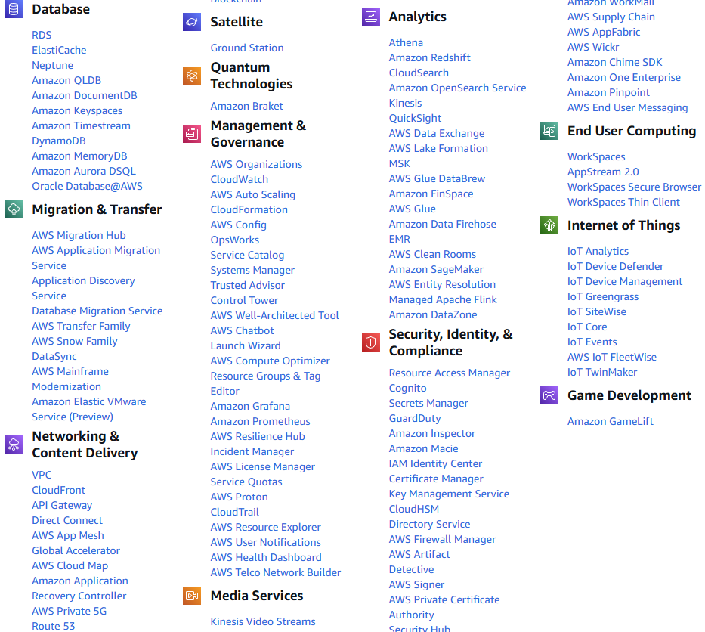
List of All Services

Slide 15
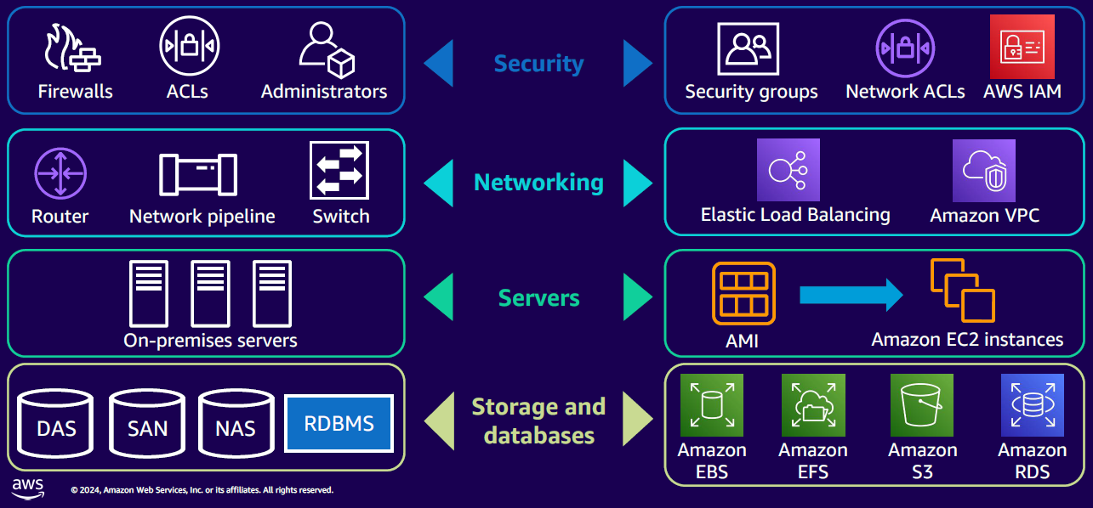
AWS Core Infrastructure-as-a-Service (IaaS)
Reference: AWSome Day, Michalynn J. Koziol (2024)
Notes:
Amazon Machine Image (AMI)

Slide 16


Slide 17
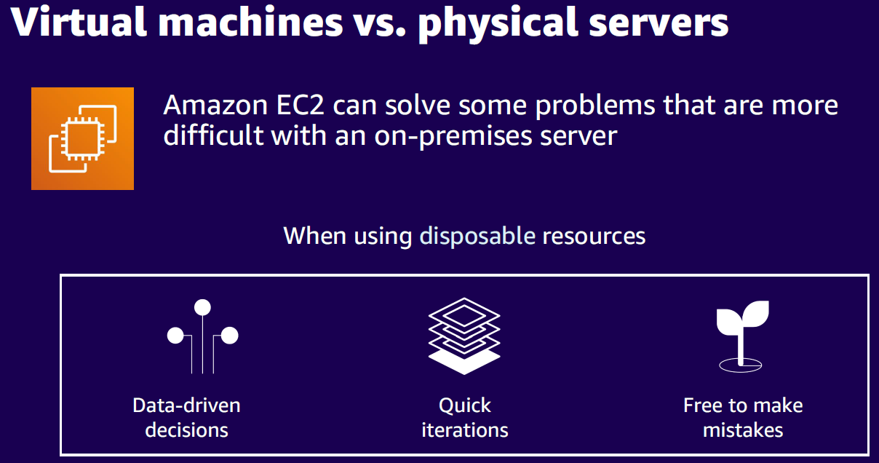
Reference: AWSome Day, Michalynn J. Koziol (2024)

Slide 18
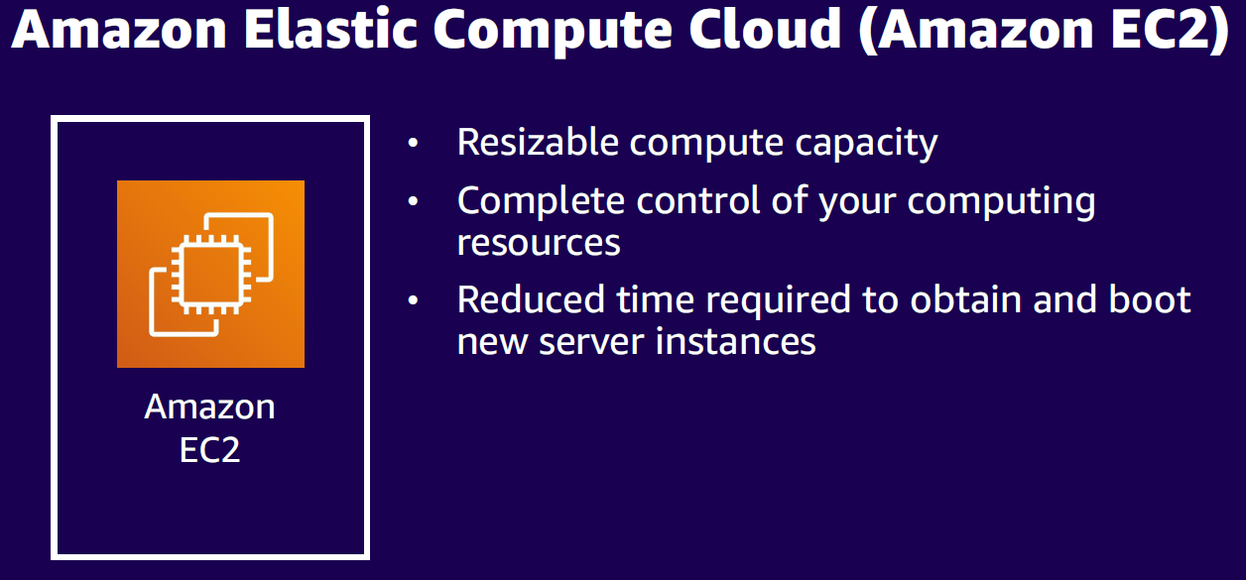
Reference: AWSome Day, Michalynn J. Koziol (2024)

Slide 19
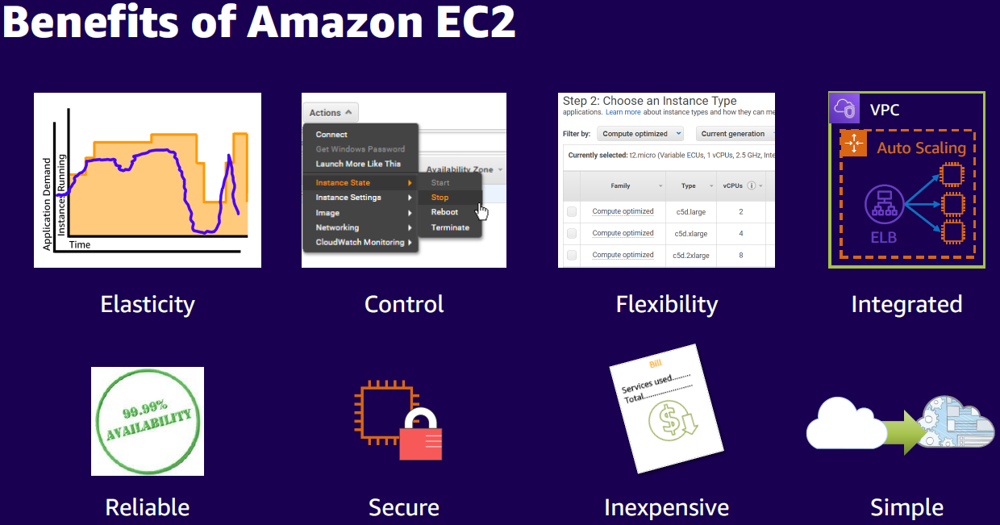
Reference: AWSome Day, Michalynn J. Koziol (2024)

Slide 20
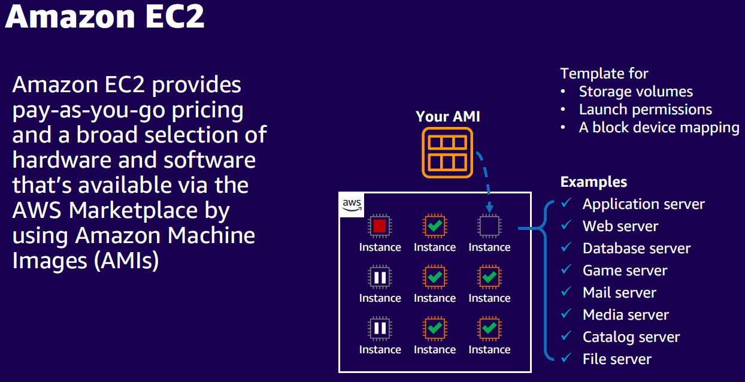
Reference: AWSome Day, Michalynn J. Koziol (2024)

Slide 21
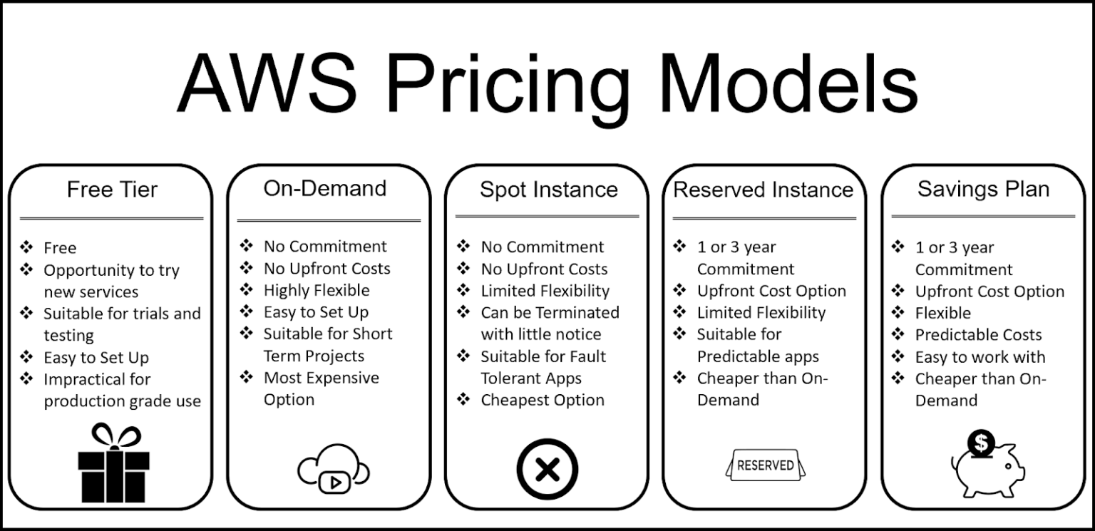
https://zesty.co/blog/what-are-the-aws-pricing-models/
Notes:
In AWS, Reserved Instances (RIs) commit to specific resources for a set period of time, while Savings Plans commit to spending a set amount of money per hour. Also, Saving Plans have higher flexibility and broader coverage than Reserved Instances.

Slide 22
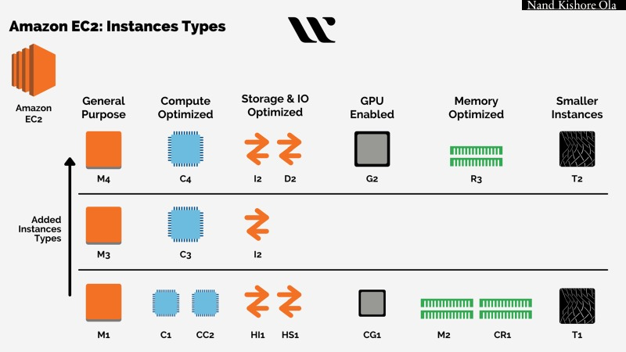

Slide 23
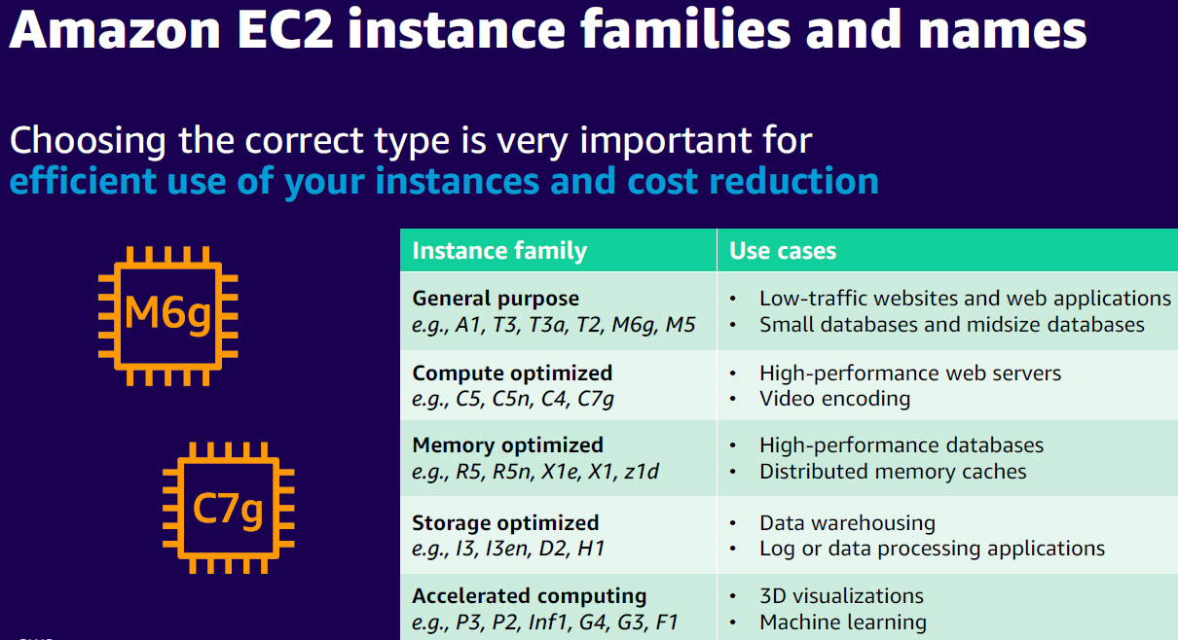
Reference: AWSome Day, Michalynn J. Koziol (2024)

Slide 24
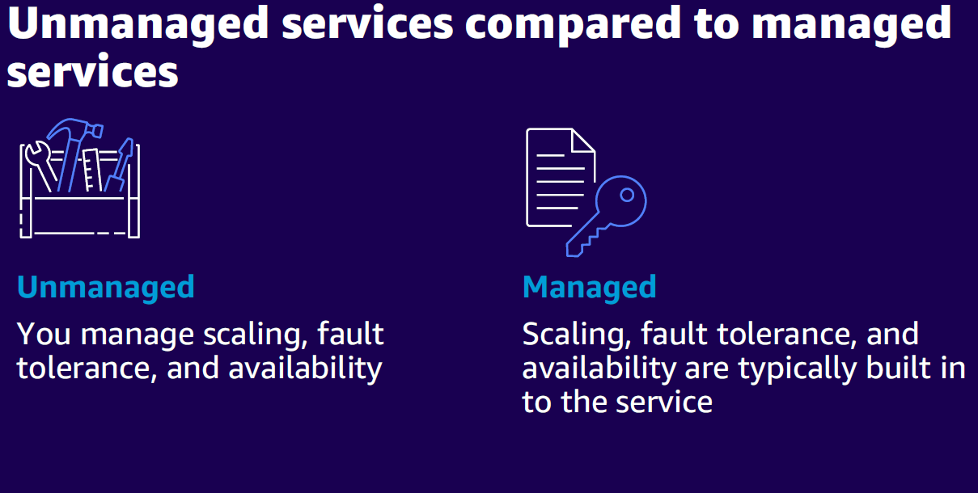
Reference: AWSome Day, Michalynn J. Koziol (2024)

Slide 25
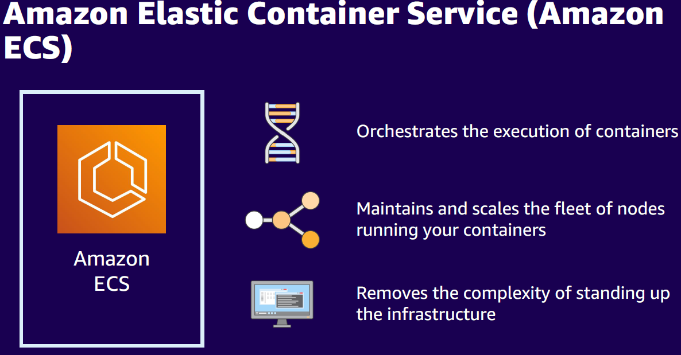
Reference: AWSome Day, Michalynn J. Koziol (2024)

Slide 26
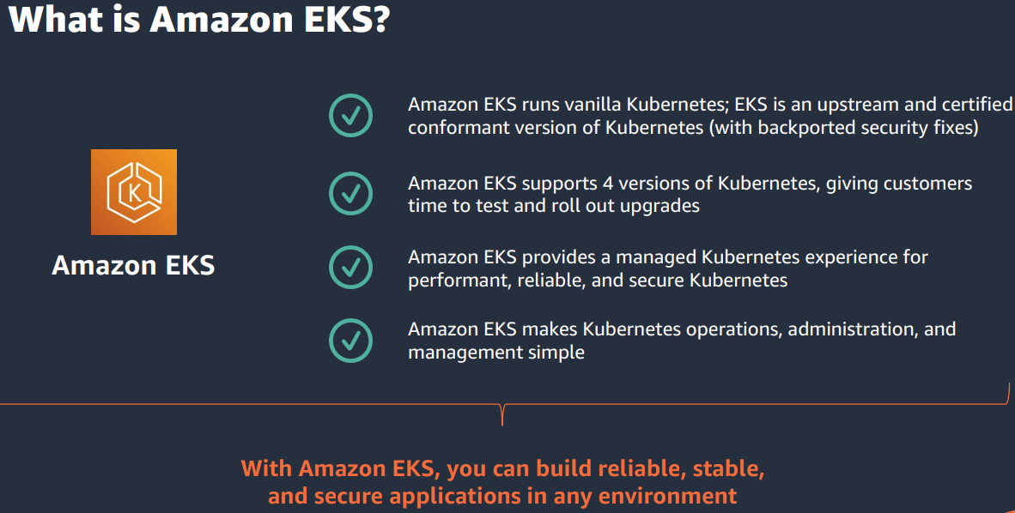
https://pages.awscloud.com/rs/112-TZM-766/images/SCMWQ1D1S2T2_Getting%20Started%20with%20Amazon%20EKS.pdf

Slide 27
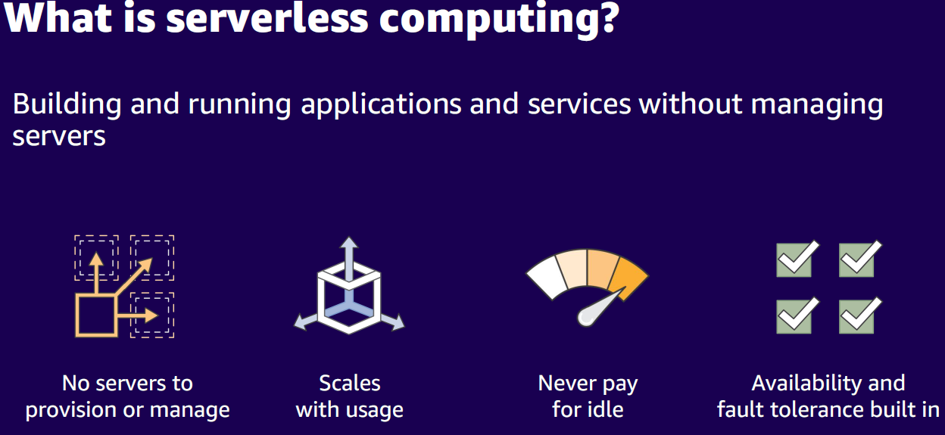
Reference: AWSome Day, Michalynn J. Koziol (2024)

Slide 28
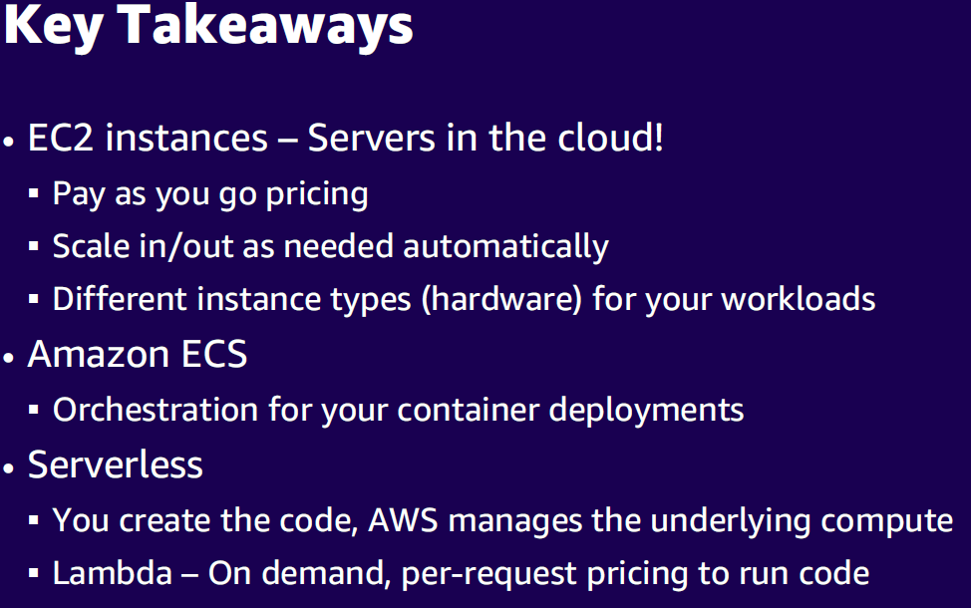
Reference: AWSome Day, Michalynn J. Koziol (2024)

Slide 29
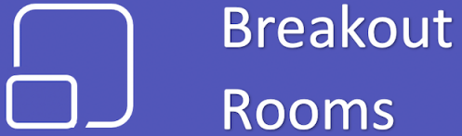
Spin Up Your (First) Amazon EC2 Instance in 10 Minutes
1
For this exercise, log into the AWS Management Console, navigate to the EC2 service & launch a new Ubuntu instance (e.g., Ubuntu Server AMI) with a t2.micro instance type.
Create a key pair for secure access and configure your security group to allow inbound traffic on port 22 for SSH.
Once the instance is running, use PuTTY (with the .ppk file associated with your key pair) to connect to the instance’s public IP address as the “ubuntu” user. After successfully logging in, run $ sudo apt-get update to refresh package listings, and then install NGINX and cURL by running $ sudo apt-get install -y nginx curl.

Slide 30
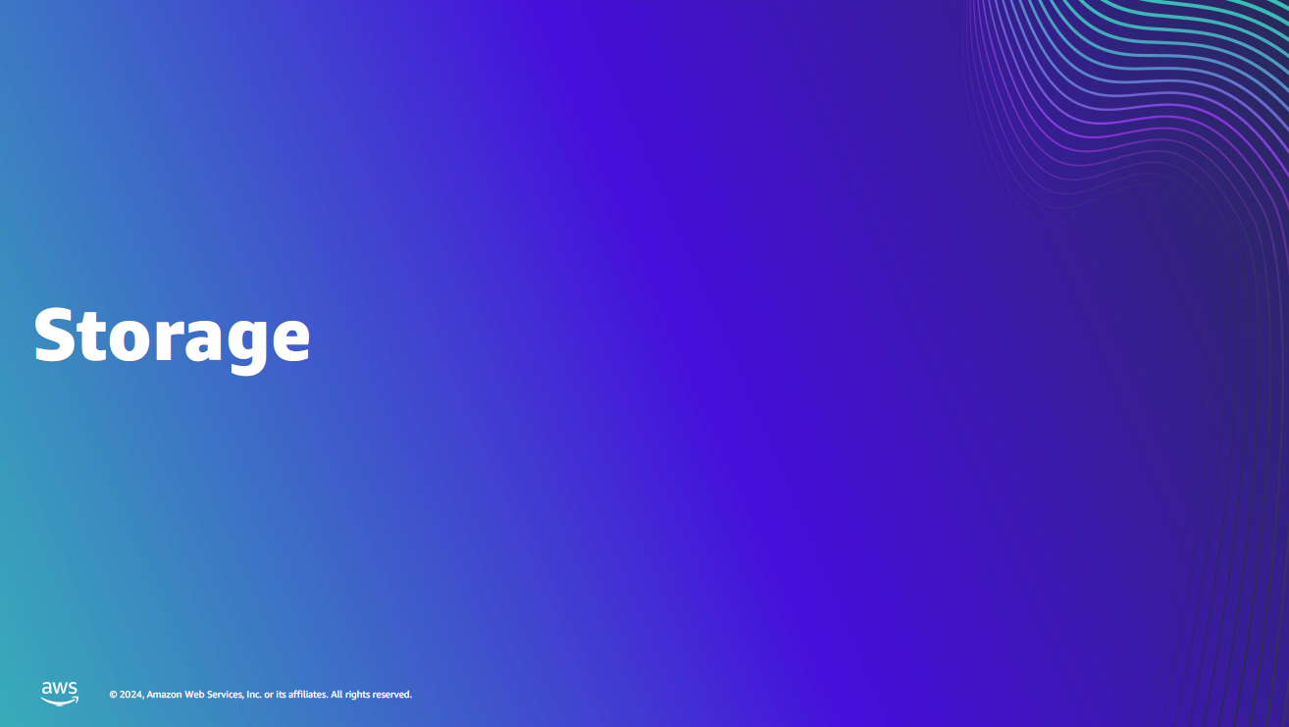

Slide 31
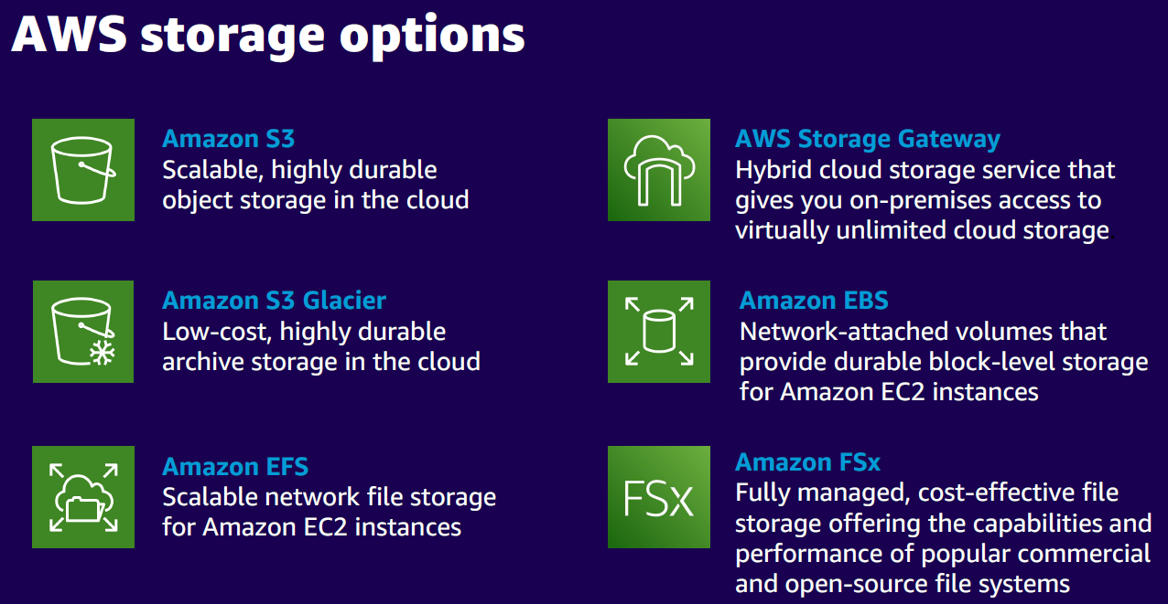
Reference: AWSome Day, Michalynn J. Koziol (2024)

Slide 32
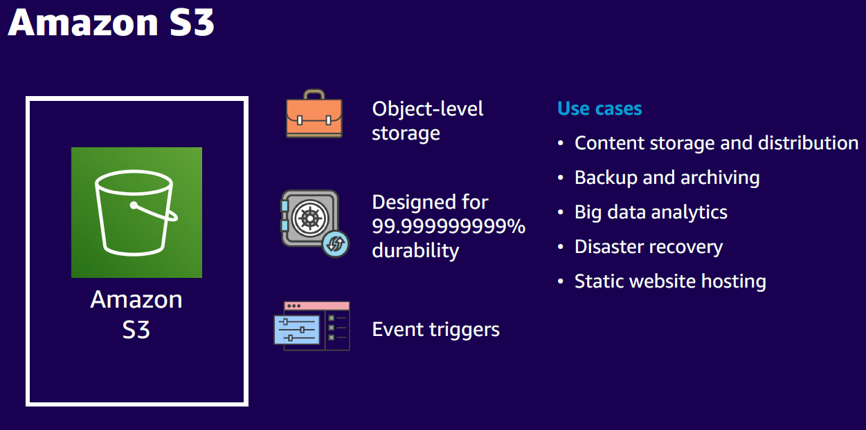
Reference: AWSome Day, Michalynn J. Koziol (2024)
Notes:
99.999999999% durability means that if you store 10 million (10,000,000) objects in S3, you can expect to lose one object every 10,000 years.This is because S3 is designed to withstand hardware failures, disk corruption, and even data center outages without losing your data.

Slide 33

Simple Storage Service (S3)
A bucket is a container for objects and describes location, logging, accounting, and access control. A bucket can hold any number of objects, which are files of up to 5TB. A bucket has a name that must be globally unique.
Fundamental operations corresponding to HTTP actions:
http://bucket.s3.amazonaws.com/object
POST a new object or update an existing object.
GET an existing object from a bucket.
DELETE an object from the bucket
LIST keys present in a bucket, with a filter.
A bucket has a flat directory structure.

Slide 34
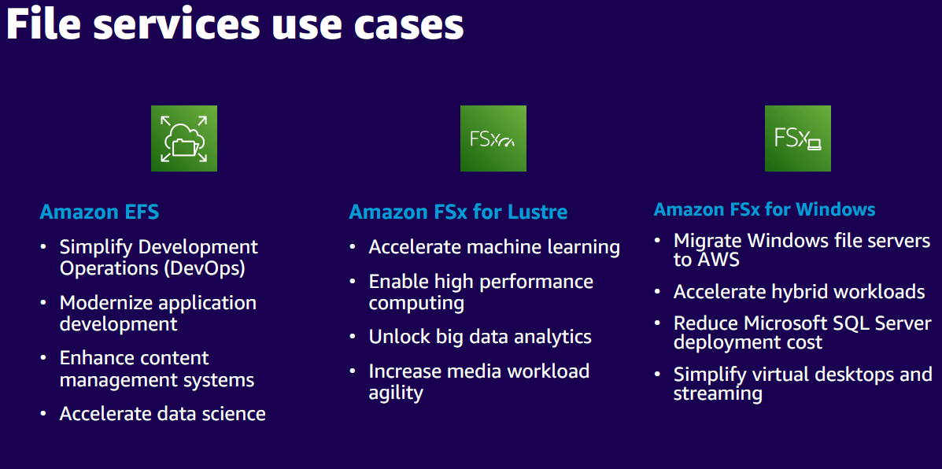
Reference: AWSome Day, Michalynn J. Koziol (2024)

Slide 35
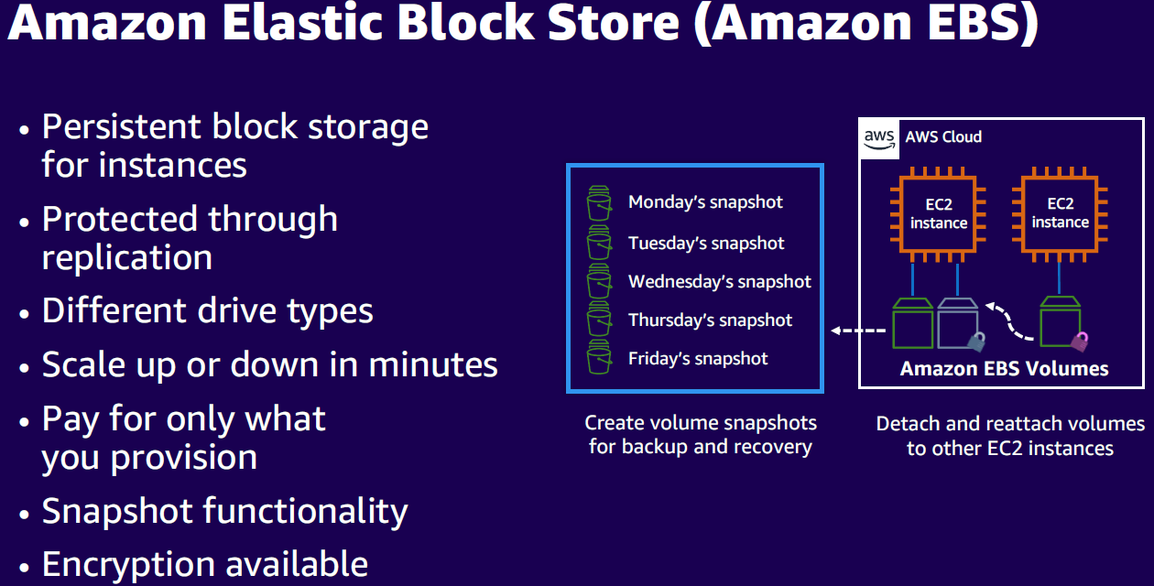
Reference: AWSome Day, Michalynn J. Koziol (2024)
Notes:
EBS is like a USB drive attached over network (Network USB Drive).

Slide 36
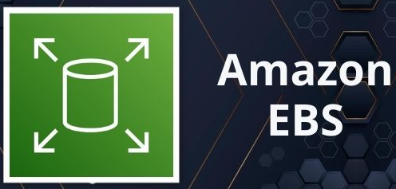
Elastic Block Store (EBS)
An EBS volume is a virtual disk of a fixed size with a block read/write interface. It can be mounted as a file-system on a running EC2 instance where it can be updated incrementally. Unlike an instance store, an EBS volume is persistent.
Compare to an S3 object, which is essentially a file that must be accessed in its entirety.
Fundamental operations:
CREATE a new volume (1GB-1TB)
COPY a volume from an existing EBS volume or S3 object.
MOUNT on one instance at a time.
SNAPSHOT current state to an S3 object.

Slide 37
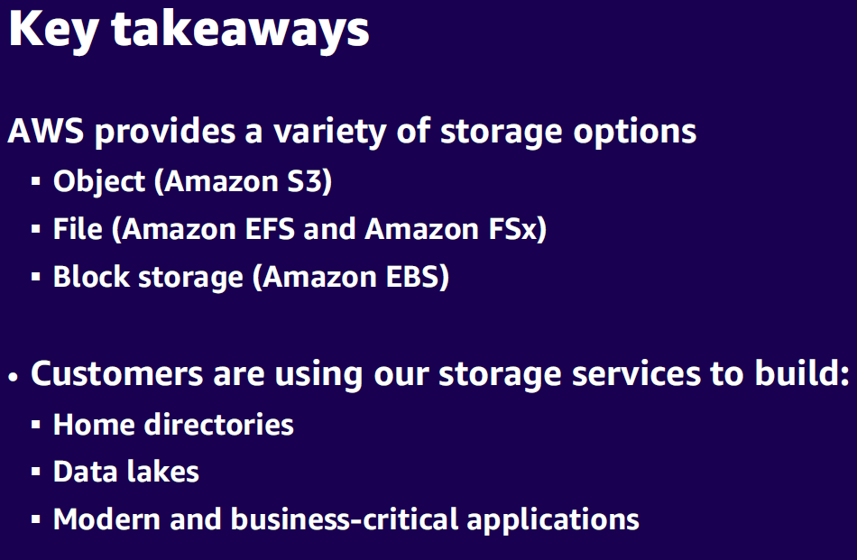
Reference: AWSome Day, Michalynn J. Koziol (2024)

Slide 38
In this lab, you will use your Ubuntu EC2 instance (created previously) to interact with Amazon S3 by creating or identifying a new S3 bucket, configuring your instance to access S3, and uploading a file to confirm successful connectivity.
2
First, log in to the AWS Management Console, navigate to S3, click Create bucket, specify a unique name (e.g., my-lab-bucket-123), select a region, and complete setup. Next, on your EC2 instance, install the AWS CLI if not already installed (using sudo apt-get update && sudo apt-get install -y awscli), then either attach an IAM role via the EC2 console or run “aws configure” to enter your credentials.
Create a simple file on your instance (e.g., echo "Hello, S3 World!" > s3test.txt), then run aws s3 cp s3test.txt s3://my-lab-bucket-123/ to upload it & verify with aws s3 ls s3://my-lab-bucket-123/.
For extra confirmation, remove the local file (rm s3test.txt), download it back using aws s3 cp s3://my-lab-bucket-123/s3test.txt and view its contents (cat s3test.txt). Finally, to clean up, remove the file from the bucket (aws s3 rm s3://my-lab-bucket-123/s3test.txt) and optionally delete the entire bucket.

Slide 39


Slide 40
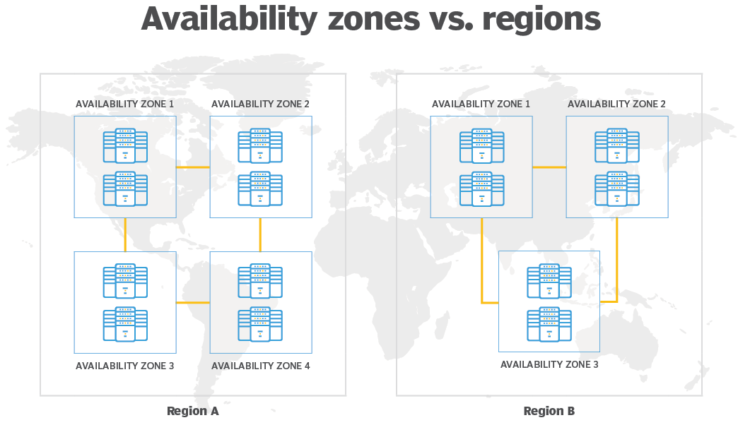
Notes:
An AWS Region is a cluster of data centers in a specific geographic area, such as the Northeastern United States or Western Europe. Each AWS Region includes multiple AZs. However, each AZ is restricted to a specific AWS Region. You can use multiple AZs within one Region, but you can't use the same AZ across multiple Regions. It is a best practice to choose a region that is geographically close to users; this reduces latency because data reaches the users more quickly. An AZ is a standalone data center or set of data centers within a Region. Each AZ operates independently, so a failure in one won't affect others. In disaster recovery plans, enterprises use multiple AZs to increase redundancy and reliability.

Slide 41
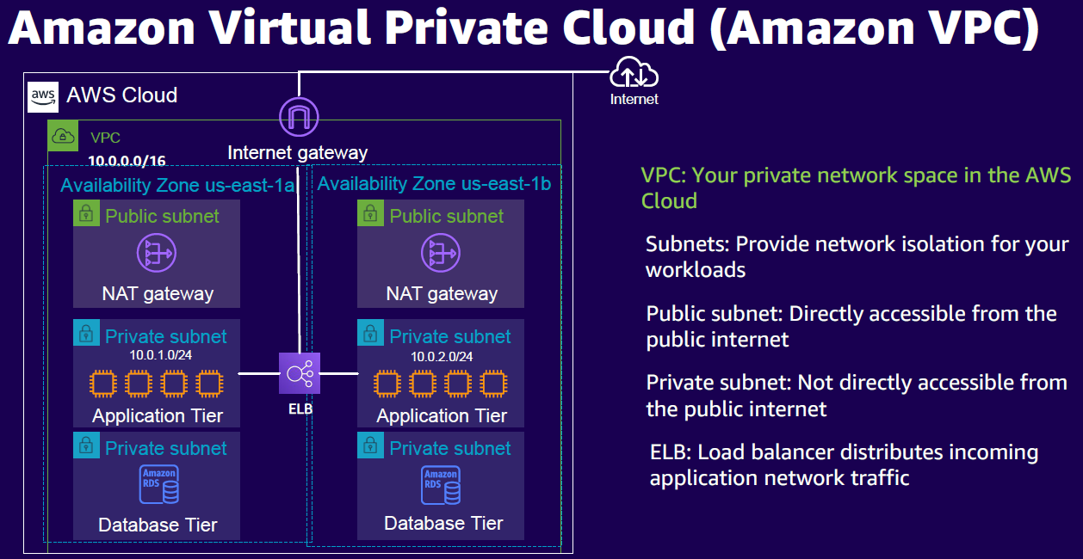
Reference: AWSome Day, Michalynn J. Koziol (2024)

Slide 42
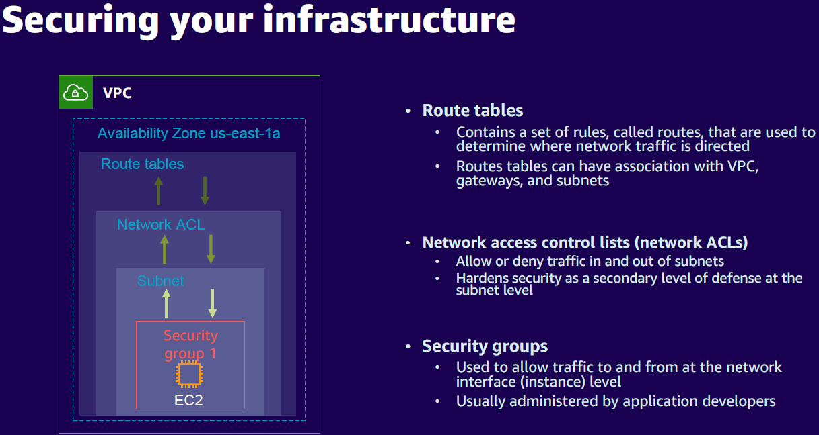
Reference: AWSome Day, Michalynn J. Koziol (2024)

Slide 43
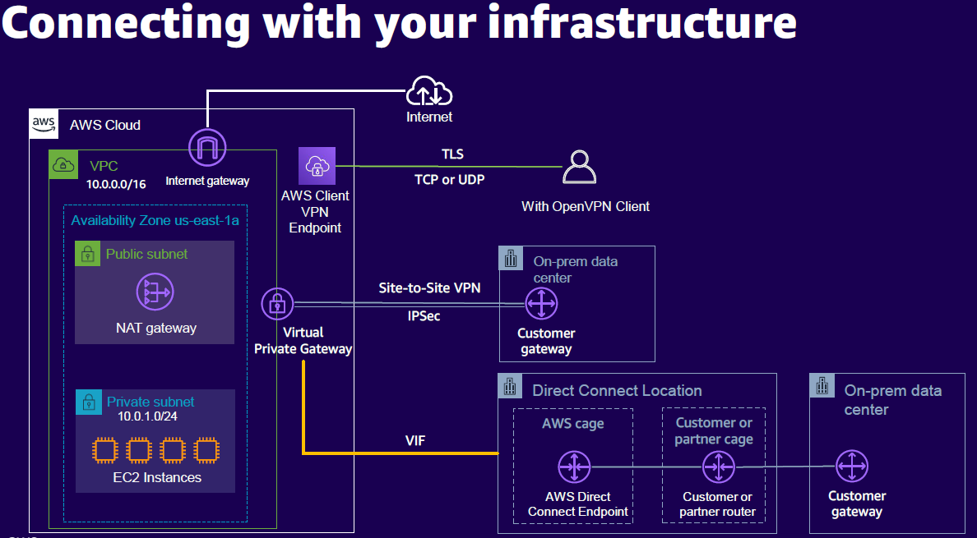
Reference: AWSome Day, Michalynn J. Koziol (2024)

Slide 44
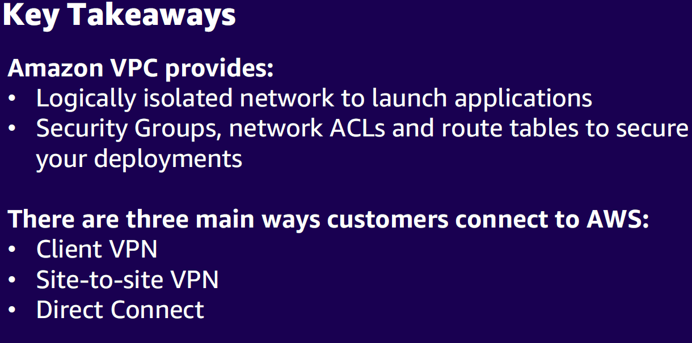
Reference: AWSome Day, Michalynn J. Koziol (2024)

Slide 45


Slide 46
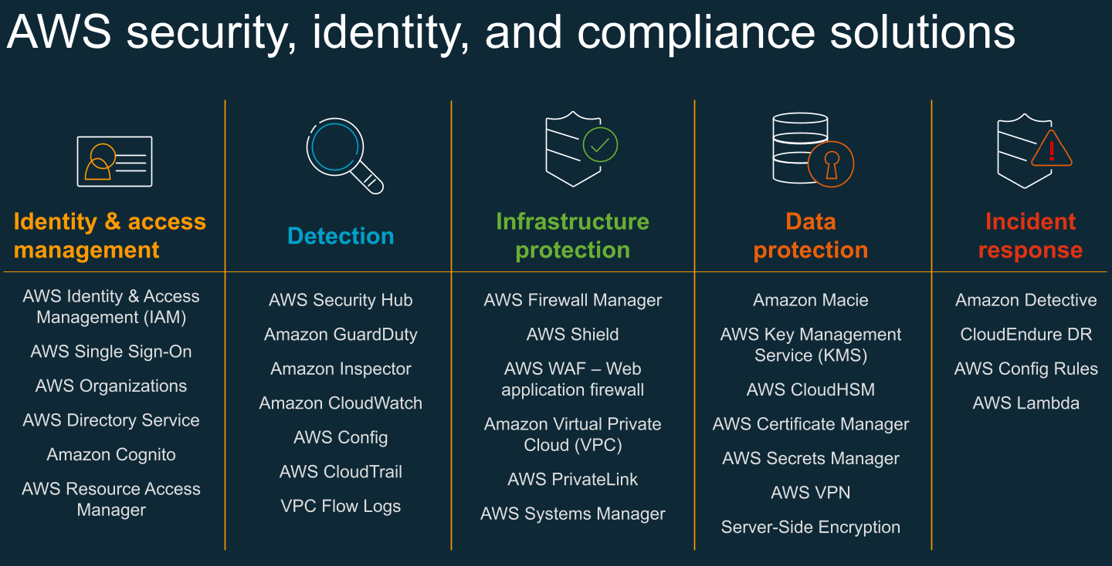
https://allcloud.io/blog/aws-security-panel-summary/

Slide 47
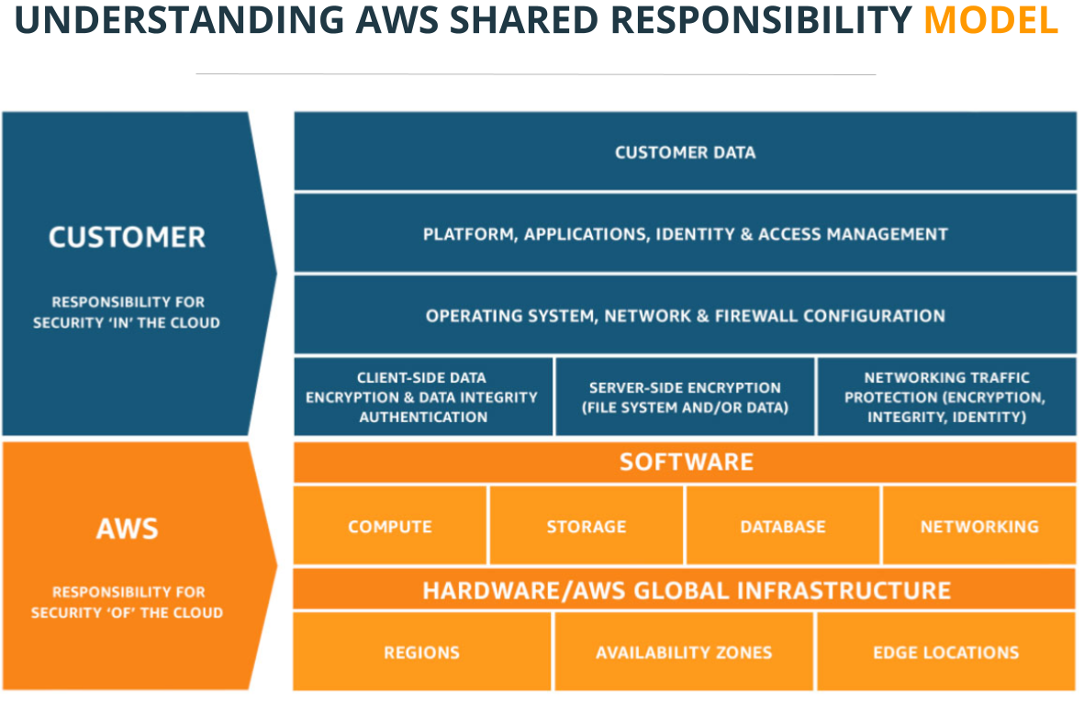
https://allcloud.io/blog/aws-security-panel-summary/

Slide 48
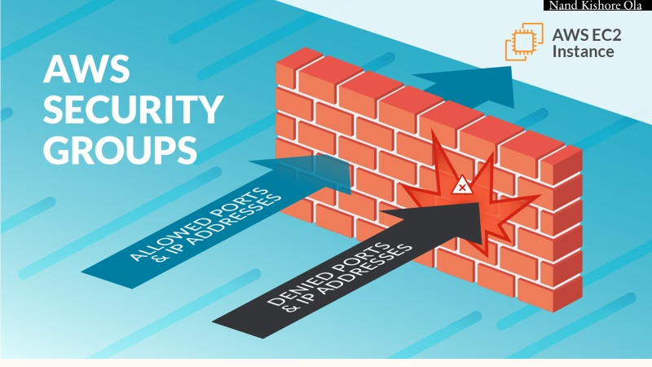

Slide 49
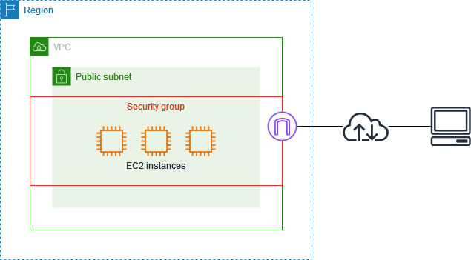
AWS Security Groups
Notes:
A security group can be used only in the VPC for which it is created. You can associate each instance with multiple security groups, and you can associate each security group with multiple instances. You add rules to each security group that allow traffic to or from its associated instances. You can modify the rules for a security group at any time. The following diagram shows a VPC with a subnet, an internet gateway, and a security group. The subnet contains EC2 instances. The security group is associated with the instances. The only traffic that reaches the instance is the traffic allowed by the security group rules. For example, if the security group contains a rule that allows web traffic from your network, then you can connect to your instance from your computer using HTTP/HTTPS. Security groups are stateful—if you send a request from your instance, the response traffic for that request is allowed to flow in regardless of inbound security group rules. Also, responses to allowed inbound traffic are allowed to flow out, regardless of outbound rules.

Slide 50
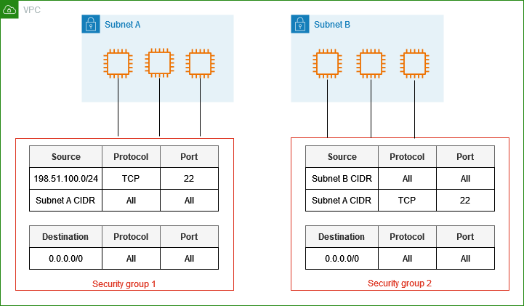
AWS Security Groups

Slide 51
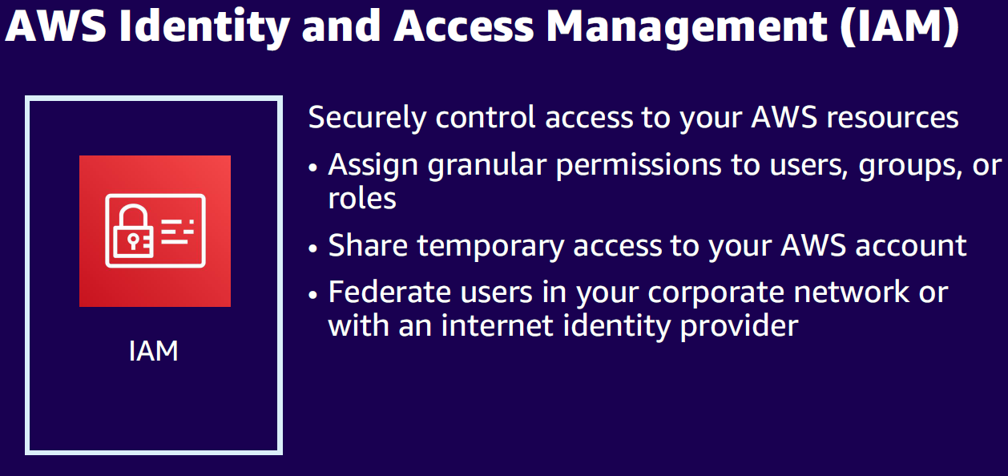

Slide 52
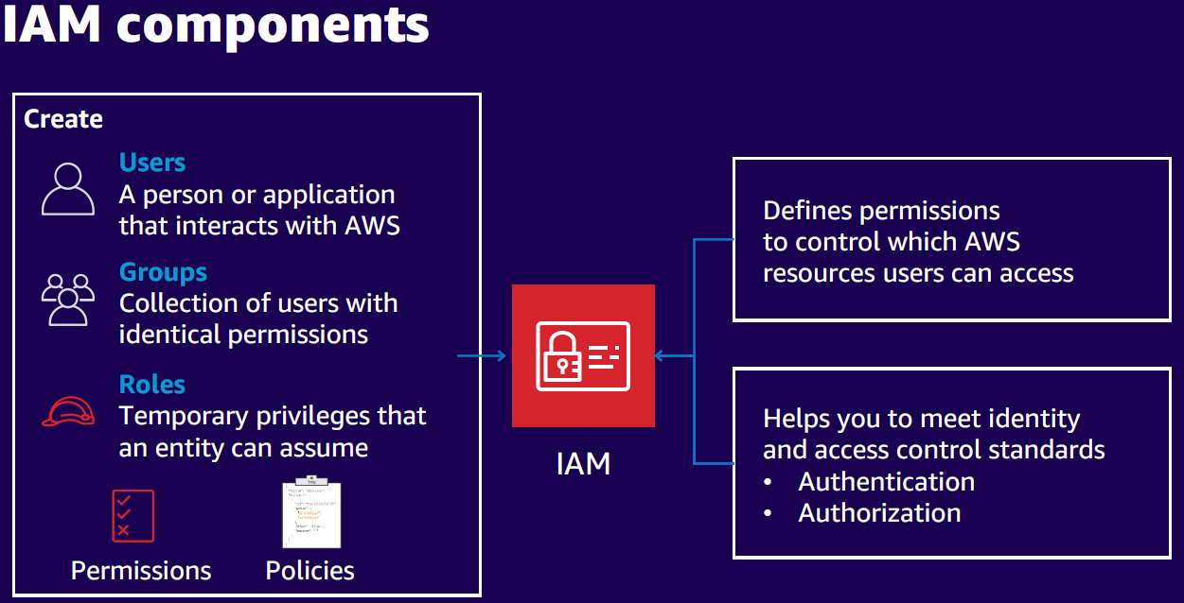

Slide 53
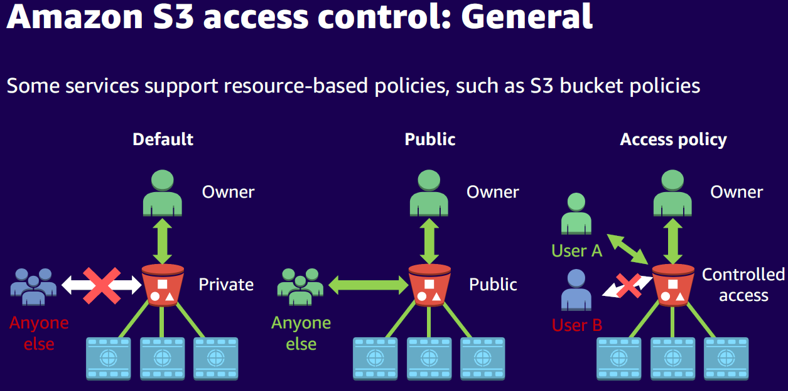

Slide 54
For this lab, first log in to AWS, open the VPC console, and note how the default VPC is configured with one or more subnets; confirm that your instance is in one of these subnets.
3
Next, go to the EC2 console, select your instance, and under Security, locate and edit the inbound rules of its Security Group: remove “0.0.0.0/0” if present for HTTP, and replace it with your public IP address in CIDR notation (e.g., 203.0.113.4/32). To get your public IP address visit https://ifconfig.me/ or https://ipinfo.io
Then, via SSH or EC2 Instance Connect, modify the default NGINX page (usually at /var/www/html/index.nginx-debian.html) by inserting a unique message (e.g., “Welcome to My Custom NGINX!”) to differentiate from the default. Finally, test connectivity by opening your instance’s public IP in your browser from your own machine; you should see your custom message, but anyone else not using your IP address will be blocked, demonstrating the restricted access.

Slide 55
Lecture #6 Summary
Explaining the necessity of using Public Cloud services such as Amazon Web Service (AWS).
Describing the key terminologies to deploy VMs (instances) in AWS.
Understanding security model and measures introduced by the AWS.
Explaining the storage options provided by the AWS to the users
Grasping Virtual Private Cloud (VPC) concept and its applications in public cloud.
Finding out how to define a Security Group to manage access to instances.

Slide 56

End of Lecture #6
THANK Y☺U
- Dawood Sajjadi

